Slide 1
CS239-Lecture 15 Transactions
Madan Musuvathi
Visiting Professor, UCLA
Principal Researcher, Microsoft Research

Slide 2
No Compromises: Distributed Transactions with Consistency, Availability, and Performance
Aleksandar Dragojevic, Dushyanth Narayanan, Edmund B. Nightingale, ´ Matthew Renzelmann, Alex Shamis, Anirudh Badam, Miguel Castro
Presented by Lun Liu

Slide 3
Distributed Transactions
Transaction
A unit of work that you want to treat as a “whole”
ACID
Distributed transaction provides powerful abstraction
Simplify building and reasoning about distributed systems
Previous implementations performed poorly
Believed to be inherently slow
Not widely used

Slide 4
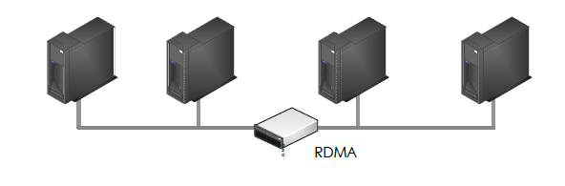
Hardware Trends
Modern cluster
Large main memory
Non-volatile memory
Fast network with RDMA

Slide 5
Remote Direct Memory Access (RDMA)
Read/ write remote memory
NIC (Network Interface Controller) performs DMA (direct memory access) request

Slide 6
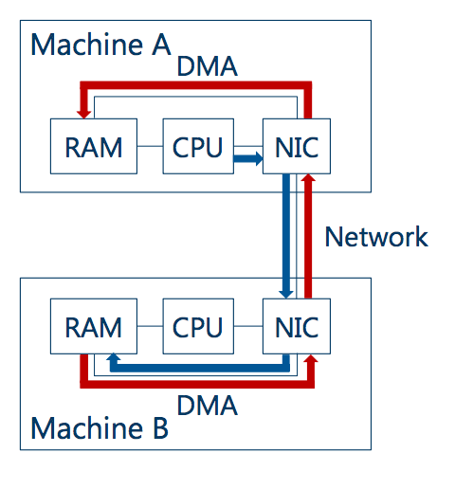
Remote Memory Direct Access (RDMA)

Slide 7
Remote Direct Memory Access (RDMA)
Read/ write remote memory
NIC performs DMA (direct memory access) request
Great performance
Bypasses the kernel
Bypasses the remote CPU

Slide 8
Hardware Trends
Modern cluster
Large main memory
Non-volatile memory
Fast network with RDMA
Eliminates storage and network bottlenecks but leaves the CPU bottlenecks

Slide 9
FaRM: No Need to Compromise
Main memory distributed computing platform
Use hardware effectively
Strict serializability
High performance
Durability
High availability

Slide 10
Outline
FaRM background
Transaction protocol
Failure recovery
Evaluation

Slide 11
farm background

Slide 12
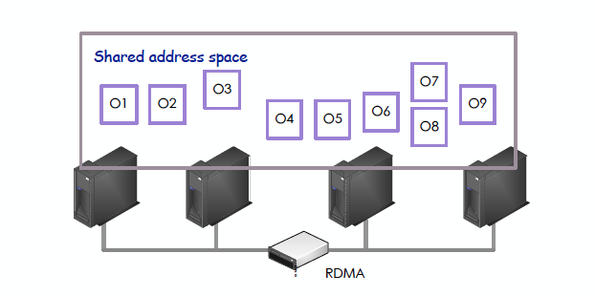
FaRM Programming Model
Distributed shared memory abstraction
FaRM API provides transparent access to local and remote objects

Slide 13
FaRM Programming Model
Application thread can start a transaction
Becomes the coordinator
During transaction, can execute arbitrary logic as well as read, write, allocate, free.
At the end of the execution, invoke FaRM to commit.

Slide 14
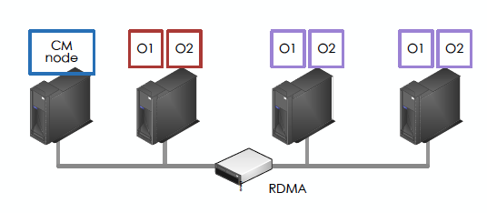
FaRM Architecture
Primary – backup for fault tolerance
Configuration Manager(CM)
Manage leases, detect failures, coordinate recovery

Slide 15
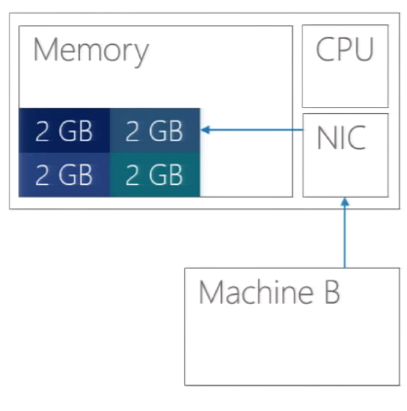
RDMA Read in FaRM

Slide 16
RDMA Read in FaRM

Slide 17
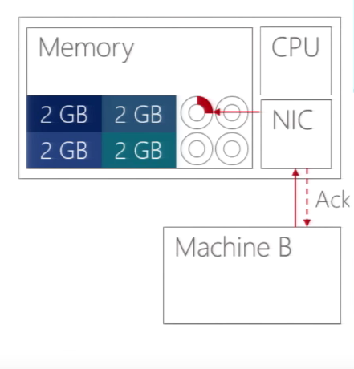
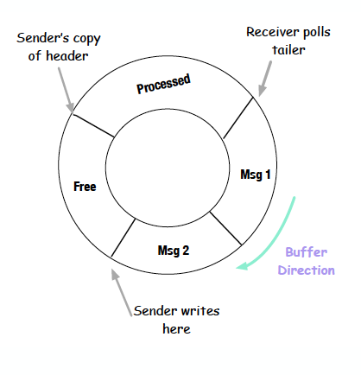
RDMA Write in FaRM

Slide 18
Transaction protocol

Slide 19
FaRM Transaction Execution
Execute
C
P1
B1
P2
B2
One-sided RDMA read
Buffer writes as local

Slide 20
Two Phase Commit
Execute
Prepare
Commit
C
P1
B1
P2
B2
Two round-trip message passing
Requires all machines’ CPU

Slide 21
FaRM Commit
Use one-sided RDMA operations
Reduce message counts
Optimistic Concurrency Control (OCC) + read validation
Version number
Speculative execution -> lock write set -> validate read set (decision point) -> commit and unlock

Slide 22
FaRM Commit
Execute
Lock
C
P1
B1
P2
B2
Writes LOCK record to primary of written objects
Primary attempts to lock and sends back message reporting succeed or not

Slide 23
FaRM Commit
Execute
Lock
Validate
Decision
C
P1
B1
P2
B2
Validates read set using one-sided RDMA

Slide 24
FaRM Commit
Execute
Lock
Validate
Replicate
C
P1
B1
P2
B2
Logs to Backups using COMMIT-BACKUP
Coordinator waits until receives all hardware ack

Slide 25
FaRM Commit
Execute
Lock
Validate
Replicate
Update and Unlock
C
P1
B1
P2
B2
Writes COMMIT-PRIMARY
Primary processes by updating and unlocking
Responds to application upon receiving one hardware ack

Slide 26
FaRM Commit
Execute
Lock
Validate
Replicate
Update and Unlock
Truncate
C
P1
B1
P2
B2
Coordinator truncates after receiving all ack from Primaries
Piggybacking in other log records
Backups apply updates at truncation time

Slide 27
FaRM Commit Correctness
Serialization point
Read-write Tx: all write locks acquired
Read-only Tx: last read
Equivalent to committing atomically at this point

Slide 28
FaRM Commit Performance
Use primary - backup to reduce number of copies of data
Use one-sided RDMA extensively
P_{w}(f + 3) RDMA writes
P_{r} RDMA reads

Slide 29
Failure recovery

Slide 30
One Sided Operations Complicate Recovery
CPU does not process remote access
Configuration change
Precise membership
Recovery
Drain logs before recovering

Slide 31
High Availability
Short failure detection time
Data available instantly
A backup promoted to primary
Use parallelism
New transactions in parallel with recovery
Recover transactions in parallel
Recover data in parallel

Slide 32
Failure Recovery Steps
Detect failure
Reconfiguration
Recover transactions
Recover data

Slide 33
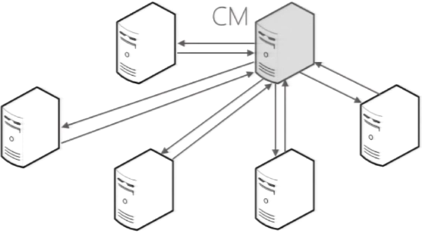
Failure Detection
FaRM uses leases to detect failure

Slide 34
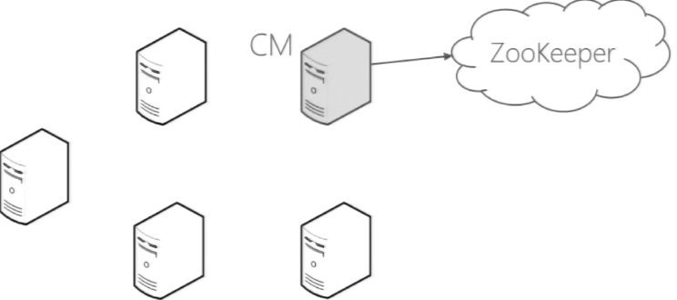
Failure Detection
Short lease interval, high availability

Slide 35
Reconfiguration
suspect S3
CM=S1
S2
S3
S4
Probe

Slide 36
Reconfiguration
ZooKeeper
suspect S3
<9,…> -> <10, {S1,S2,S4}, F, CM=S1>
CM=S1
REMAP
S2
S3
S4
Probe
Backup becomes primary, load balancing

Slide 37
Reconfiguration
ZooKeeper
suspect S3
<9,…> -> <10, {S1,S2,S4}, F, CM=S1>
CM=S1
REMAP
S2
S3
S4
Probe
NEW-CONFIG
NEW-CONFIG-COMMIT
NEW-CONFIG-ACK
Machines apply new configurations, stop accessing to affected region

Slide 38
Reconfiguration
ZooKeeper
suspect S3
<9,…> -> <10, {S1,S2,S4}, F, CM=S1>
CM=S1
REMAP
S2
S3
S4
Probe
NEW-CONFIG
NEW-CONFIG-COMMIT
NEW-CONFIG-ACK
Recovery starts after everyone stops accessing recovering regions

Slide 39
Transaction Recovery
C
NEW-CONFIG-COMMIT
P
Block
Drain
B1
Block
Drain
B2
Block
Drain
NEW-CONFIG
Process all the messages in logs that haven’t been processed

Slide 40
Transaction Recovery
C
P
Block
Drain
Find Recovering
Lock
B1
Block
Drain
B2
Block
Drain
Region looks as it is before the failure

Slide 41
Transaction Recovery
Region is active
C
P
Block
Drain
Find Recovering
Lock
B1
Block
Drain
B2
Block
Drain
Operations on the region in parallel with recovery

Slide 42
Transaction Recovery
Region is active
C
Decide
Vote
P
Block
Drain
Find Recovering
Lock
B1
Block
Drain
Replicate logs
B2
Block
Drain
New coordinators are spread around cluster

Slide 43
Data Recovery
Need to re-replicate data at new backups
To tolerate failures in the future
Parallelize data replication
Done in background
Starts after locks acquired at all primaries
Paced

Slide 44
Evaluation

Slide 45
Evaluation Settings
90 machines cluster, 5 machines ZooKeeper
256 GB DRAM, 16 cores
30 threads for foreground work, 2 threads for lease manager
2x Infiniband Mellanox ConnectX-3 56 Gbps
3 way replication (1 primary 2 backups)
Standard OLTP benchmarks
TATP, TPCC

Slide 46
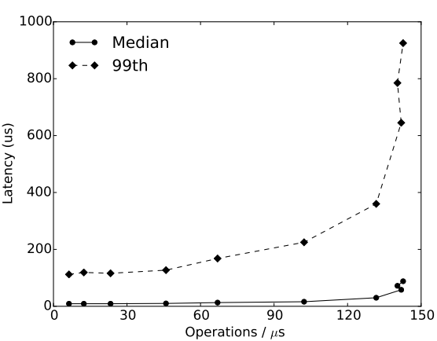
TATP Performance
Read dominated
70% single read
10% read 2-4 rows
20% updates

Slide 47
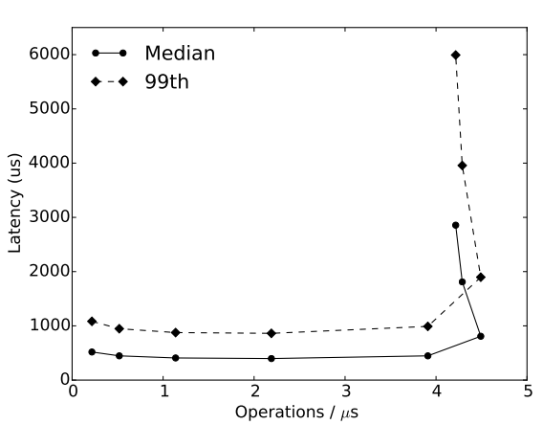
TPC-C Performance
Complex transactions
10% distributed
45% “new orders”

Slide 48
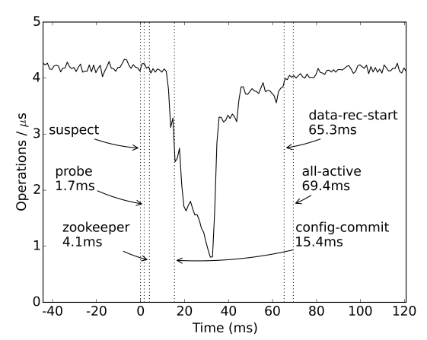
TPC-C Recovery

Slide 49
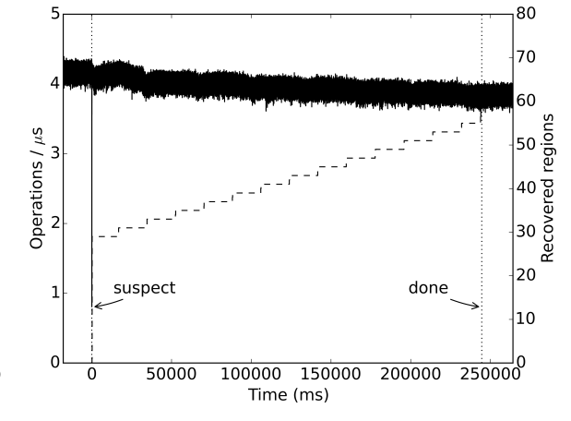
TPC-C Recovery

Slide 50
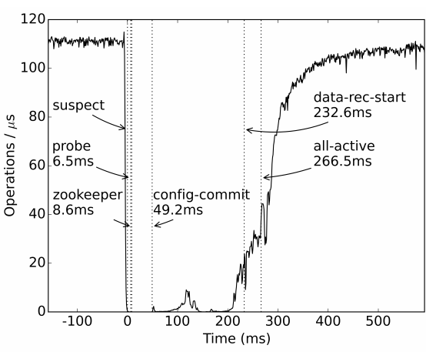
TATP 18 Machines Failing

Slide 51
Conclusion
FaRM transactions
Tailored to hardware in modern data centers
RDMA, low message counts, parallelism
High performance
High availability

Slide 52
Backup

Slide 53
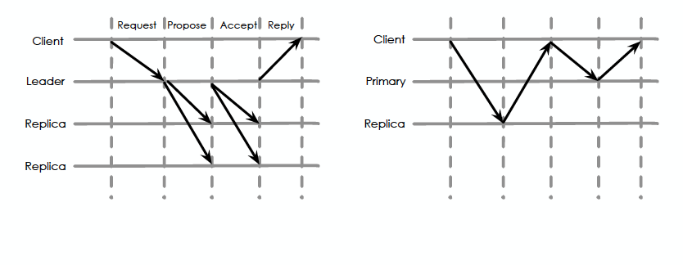
Paxos VS PB

Slide 54
Transaction and Serializability
Serializability
the outcome is equal to the outcome of transactions executed serially

Slide 55
Use one-sided RDMA operations
Reduce message counts
Effectively use parallelism

Slide 56
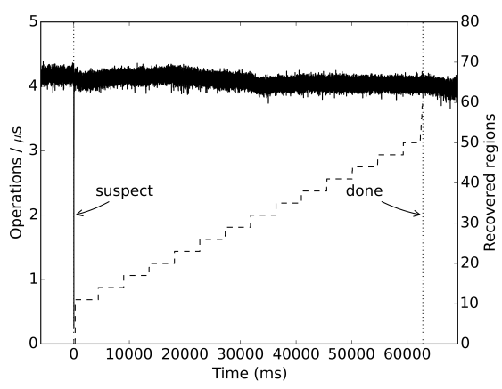
TPC-C Aggressive Data Recovery

Slide 57
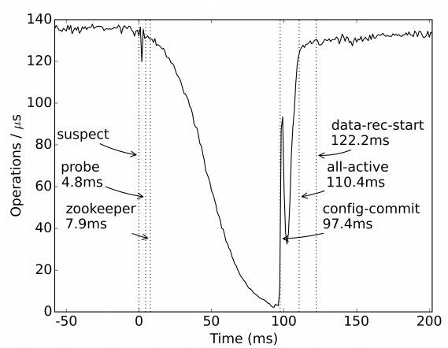
TATP CM Failure

Slide 58
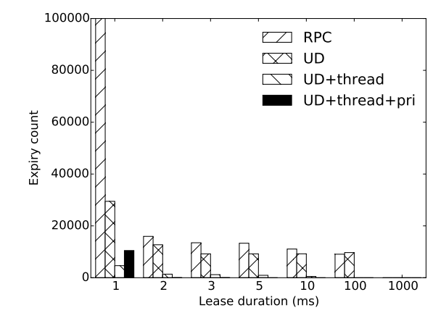
Lease Duration

Slide 59
Type-Aware Transactions for Faster Concurrent Code
Presented by Nisarg Shah
Notes:
How did you like the paper? Talk about it’s structure.
STM as a concept
Concurrent code is hard

Slide 60
Overview
Paper talks about their improvement over Software Transactional Memory (STM).
STM is an alternative to traditional locking in a programming language for consistency in concurrent applications.
Paper introduces STO (Software Transactional Objects) which are faster than STMs.
Track abstract operations on transactional datatypes.
Predicates prevent false conflicts.
Notes:
Explain the crux of the paper.
“10 transactions modifying a counter”
Why the datatype makes a difference: control over what modifys, return types of operations.

Slide 61
STM
DB transactions
Foo * getFoo() {
static Foo * pFoo = 0;
atomic {
if (pFoo != 0) // read
pFoo = new Foo(); // write(s)
}
return pFoo;
}
TL2
Notes:
Transactions simplify concurrent modifications by limiting thread interactions, and are linearizable. Isolated, atomic and can abort.
TM compiler/programmer wraps code around transactional blocks and it’ll take care of concurrency control and deadlock prevention.
Every transaction starts by reading the current value of the clock and storing it as the read-version. Then, on every read or write, the version of the particular memory location is compared to the read-version; and, if it's greater, the transaction is aborted. This guarantees that the code is executed on a consistent snapshot of memory. During commit, all write locations are locked, and version numbers of all read and write locations are re-checked.

Slide 62
Problems with STM
Not as fast as purpose-built concurrent code
Can’t be implemented at hardware level
High costs of book keeping and concurrency control
Track all objects
Locking them or taking snapshots
Solution? Abstract datatype operations!
Abstract reads, writes and predicates on transactional datatypes.
Notes:
Very expensive, for example a binary tree lookup will track every word accessed in the path of the tree. Word level granularity is a high overhead.
Abstract rather than concrete access to untyped memory.

Slide 63
Software Transactional Object [STO]
Aims to
Use the datatype semantics
Reduce book keeping
Limit false conflicts
Efficient concurrency control
Datatypes instead of Memory Words.
Vectors, trees, hash tables, priority queues. Can add your own datatype too.
Optimistic predicate verification
Based off a lot of other related work. Do go through in the paper.
Notes:
Datatypes can leverage their semantics to reduce false conflicts

Slide 64
Code
bool transfer(TBox<int>& bal1, TBox<int>& bal2, int amt) { TRANSACTION { // open new transaction
if (amt < 0 || bal1 < amt)
return false;
bal1 = bal1 - amt;
bal2 = bal2 + amt;
} RETRY(true); // commit with retry
return true;
}
Notes:
STO is a C++ lib.
Tbox<> is the transactional proxy for type <>
Abort exception

Slide 65
STO platform
TObject is the base for all Transactional Objects
Version number to track update. [ID and helper bits]
Version number protect different logical segment of state. COMMUTE!
Tracking set [class TItem: read version, write value, predicate value]
Read
Modify
Callbacks
Notes:
Commute example: Array
Read version or predicate tells STO the item should be verified during commit, write value should be locked and install needs to be called.

Slide 66
Commit protocol
Phase 1
All ‘write’ TItems are locked
Lock() callback must lock relevant segment of state
Notes:
This blocks other conflicting modifications.

Slide 67
Commit protocol
Phase 1
All ‘write’ TItems are locked
Lock() callback must lock relevant segment of state
Phase 2
Read version numbers verified
Check() callback
Notes:
Ensures no updates have occurred
Tracking set’s stored version number with live version number

Slide 68
Commit protocol
Phase 1
All ‘write’ TItems are locked
Lock() callback must lock relevant segment of state
Phase 2
Read version numbers verified
Check() callback
Transaction will commit now.
Phase 3
Install()

Slide 69
Commit protocol
Phase 1
All ‘write’ TItems are locked
Lock() callback must lock relevant segment of state
Phase 2
Read version numbers verified
Check() callback
Transaction will commit now.
Phase 3
Install()
Cleanup

Slide 70
False conflicts | Optimistic Predicates
Operations that commute do not require rolling back.
Segmentation (with version number for each)
Logical partition
Accumulated counter delta
Multiple versions of read for a no-partition datatype
Optimistic transactional predicate
TItem records a ‘predicate expression’
Notes:
Like that of an array
Like a counter’s increment and decrement, don’t expose the value!
Zero crossing example
Predicate expression is conditions under which committing the transaction is valid.

Slide 71
Opacity
User code never observes transactionally inconsistent state.
STO uses TL2 for this.
Unlike TL2, STO always records reads in the tracking set.
This version of TL2 is fast, but overheads of checks, contention on global version clock make it slow.
Notes:
Irrecoverable failures like null pointers
TL2 algorithm
Can be switched off.

Slide 72
Datatypes
Consideration:
Specification
Insert element
Absent element
Read my writes
Correctness
Composition

Slide 73
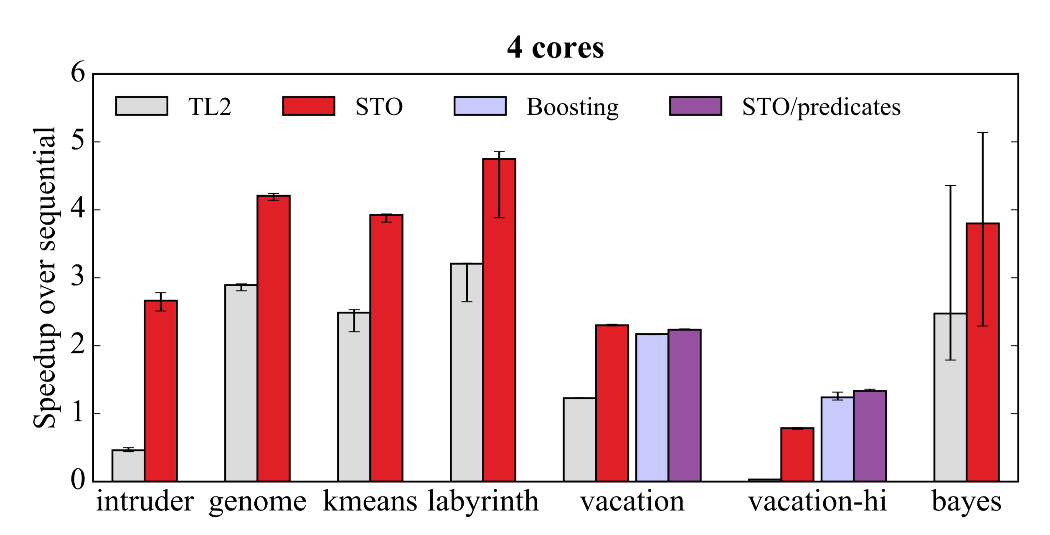
Evaluation - STAMP
Notes:
Transactional memory benchmark tool

Slide 74
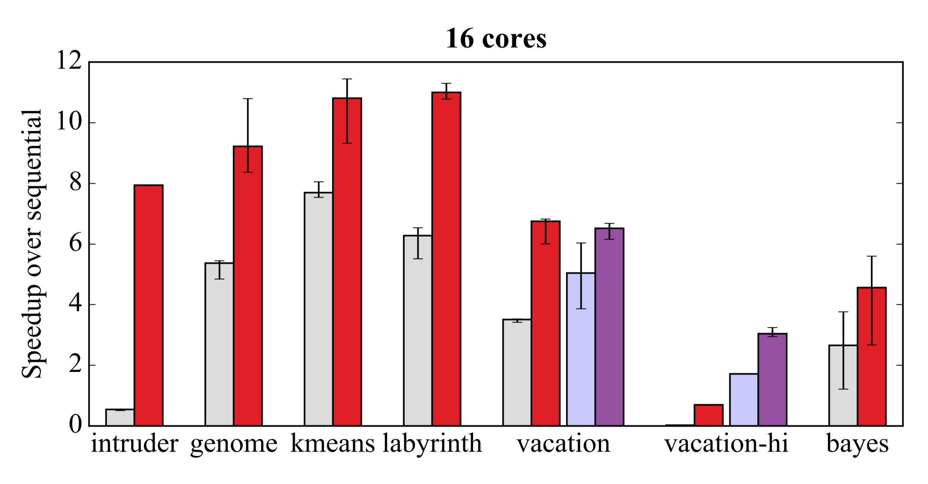
Evaluation - STAMP

Slide 75
References
https://bartoszmilewski.com/2010/09/11/beyond-locks-software-transactional-memory/

